Slide 1


ElasticTrainer: Speeding Up On-Device Training with Runtime Elastic Tensor Selection
Kai Huang, Boyuan Yang, Wei Gao
University of Pittsburgh
ACM MobiSys 2023
Notes:
Thank you for the introduction! Good morning everyone, today I am going to share with you about our recent research for on-device AI, which speed up on-device training on resource-constrained embedded devices. This is a joint work with my students Kai Huang and Boyuan Yang.

Slide 2
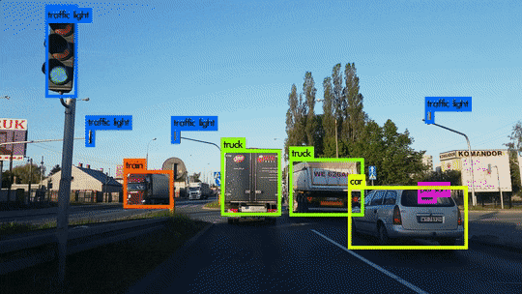
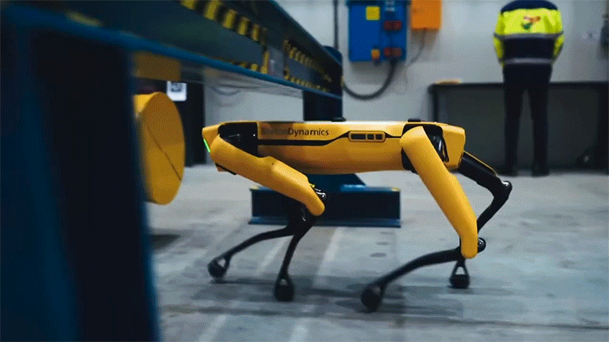


AI models should continuously learn and adapt
Promptly adapt to new online data and ever-changing environment
Category-extensible object detector
All-terrain legged robot
Mobile auto-suggestion
Snapshot of new vehicle models
Leg torque readings on unseen terrains
Recent chat history with new friends
Accurate scene perception
Adjust motor to stabilize body
Mimic your new tone
Notes:
Nowadays, neural network models have been widely deployed onto mobile and embedded devices for intelligent recognition, decision making and content generation, and these models will always need to adapt to the new online data or different environmental context.
For example, in the three applications listed here, [x] the object detector in autonomous driving should learn how to recognize new categories of objects such as the new vehicle models. [x] The autonomous robots need to learn from the real-time feedback of its motion sensors for smooth operations on harsh environments. [x] And mobile auto-suggestion algorithms should learn from user’s inputs, in order to provide personalized suggestions.
[x] In autonomous driving, object detector should be able to

Slide 3



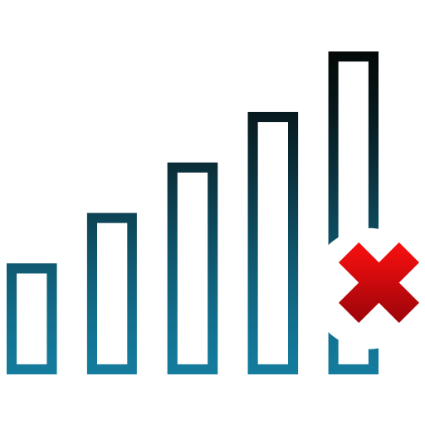
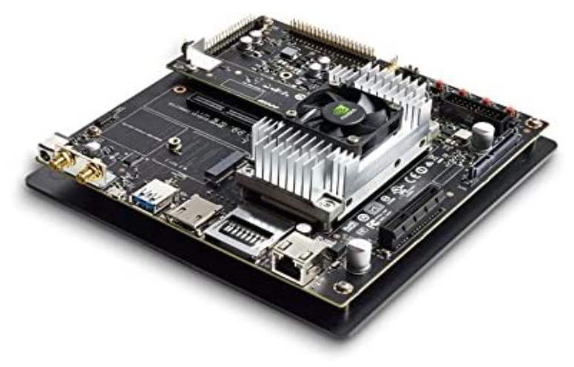
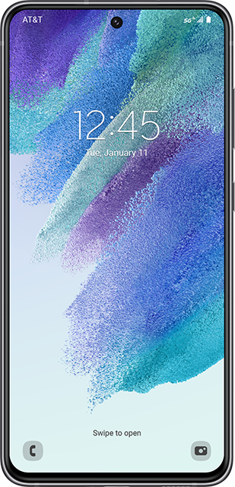


On-device model training is essential
When data privacy & timeliness of adaptation matter …
offload
On-cloud training?
On-device training !
Notes:
All these capabilities of adaptation require on-device training of the neural network models, especially when the users’ local data is sensitive and the model needs to timely adapt to such local data. In these cases, it is impossible for us to offload the training to a remote cloud server, but will have to train the model on the local device.

Slide 4

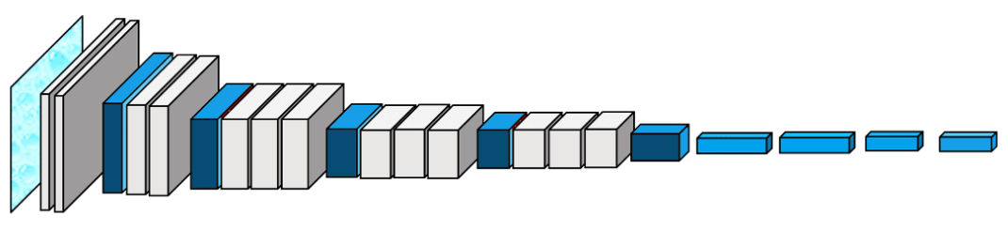
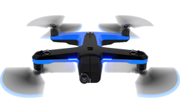
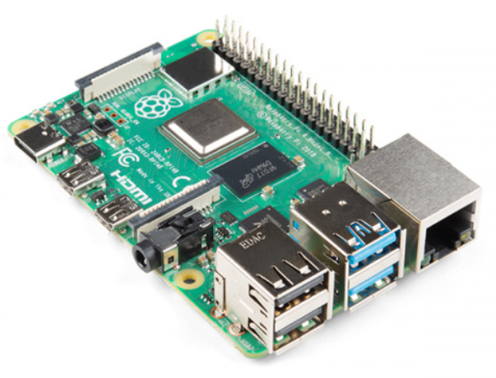




On-device training is expensive and slow
ResNet / VGG model
runtime feeding
6,000 images
Mobile GPU Platforms:
Mobile CPU Platforms:
Nvidia Jetson, High-end smartphones, …
Raspberry Pi, Wearables, …
~16 hours
~30 days
Notes:
However, training neural networks on resource-constrained mobile and embedded devices can be a significant challenge due to the limited on-device computing power.
For example, to train a ResNet or a VGG model for image recognition using 6000 training images, it can take up to 16 hours on high-end mobile GPU platforms like Nvidia Jetson or the latest smartphones. On lower-end mobile CPU platforms like Raspberry Pi or wearables, it can further take over 30 days, which is incredibly slow. Even for training the model with a single input image on these devices could take several seconds or minutes. So, there is a great need to speed up such on-device training.

Slide 5

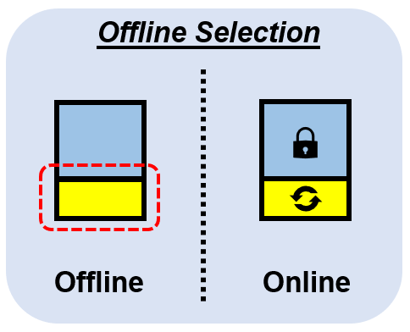
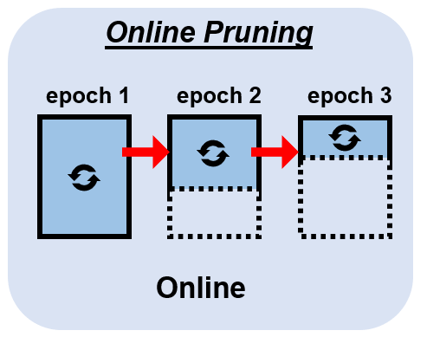
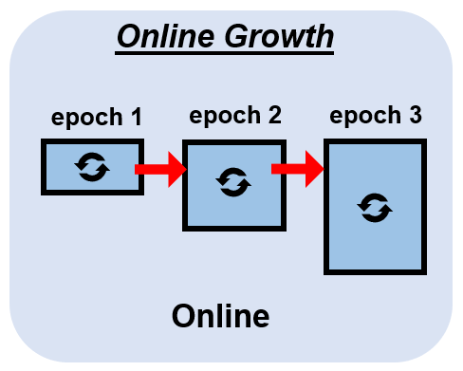
Existing Work to speed up on-device training
Offline Selection
Offline select a fixed NN portion
Cannot adapt to new data & training progress
Online Pruning
Runtime remove unimportant portions
Unrecoverable, keep losing expressiveness
Online Growth
Runtime append new NN portions
Cannot start from a strong pretrained model
Newly added portions must train from scratch
Notes:
Although on-device training has not been a well studied research topic, there are some existing machine learning techniques that can be used to speed up on-device training. In general, the basic rationale to speed up is to only train a portion of the neural network that is most relevant to the model’s prediction accuracy, and the simplest way of selecting such trainable portion is just do offline selection, but obviously this is not a good solution because it cannot adapt to the new online data patterns.
[x] instead, people suggest to gradually prune the trainable portion at run-time and remove those unimportant portions on the fly. But the key limitation of such pruning is that it is an one-way process, and the pruned parts are totally not recoverable, even if they are useful in a later stage of training.
[x] Another alternative to online speed up is to start with a small model but gradually add new trainable portions at run-time. The limitation of this approach is that the model’s representation power will be very weak at the beginning, and the newly added portions will have to be trained from scratch, which will be very expensive.

Slide 6

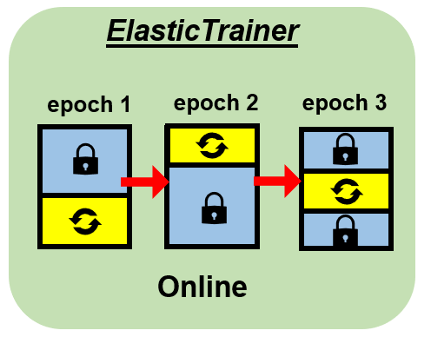


Elastic Selection for On-device Training
Elastic Selection: NN substructures can be freely removed from or added to trainable portions during training.
Ensure optimal selection in each training epoch
Layer 1
Layer 2
Layer 3
Layer 4
Layer 5
Notes:
When we look at these existing work, we found that the basic reason for their limitations is that their selection of the trainable neural network portion is a fixed and one-way process, which cannot flexibly adapt to the online new data patterns. To address this problem, we instead propose that such selection should be fully elastic, which means that every neural network substructure can be freely removed from or added to the trainable NN portions at any time during the training procedure.
In this way, in any training epoch, we evaluate how each neural network substructure contributes to the current training progress, so that we can always make sure that the training involves the optimal set of substructures that can minimize the computing cost and reserve the model’s representation power at the same time.

Slide 7

Granularity of Selection – Tensor Level
NN layer
NN weights
Input
Output
Layer-level: inaccurate, selected layer may contain many unimportant weights
Weight-level: cannot accelerate, due to the expensive fine-grained indexing of weights
Tensor-level: sufficiently accurate and can be efficiently executed by existing NN library
Notes:
Over here, you may notice that we use the word “substructure”. So in practice, such selection could be actually done at different granularities, which can be at the level of layers, weights and tensors. For example, in this case, we have a neural network with three dense layers, each layer contains two trainable tensors as groups of weights.
[x] The layer-level selection is coarse-grained and hence inaccurate, because a layer may contain both important and unimportant weights.
[x] On the other hand, although the weight-level selection is the most fine-grained, it requires fine-grained indexing of weights, which is computationally expensive in practice.
[x] Hence, in our work, we adopt tensor-level selection, which ensures accuracy and can also be efficiently executed in existing NN frameworks without extra overhead.

Slide 8

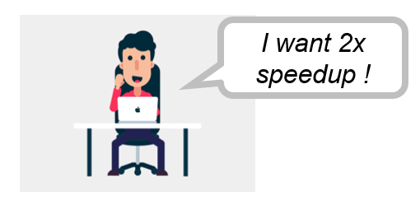
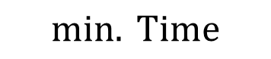
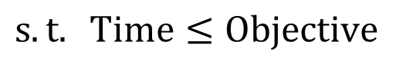
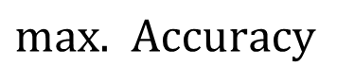
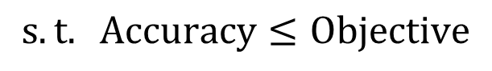
Problem Formulation of Elastic Tensor Selection
70%
Minimize training time with the accuracy objective
$$min. Time$$
$$s.t. Accuracy≤Objective$$
80%
90%
Hard to decide the appropriate accuracy objective in advance
The achievable accuracy within a reasonable time frame is unknown
Challenge 1: How to adaptively evaluate tensor importance at runtime?
Challenge 2: How to construct time model of NN training?
Challenge 3: How to efficiently solve selection problem at runtime?
Best possible accuracy = 85%
Unknown beforehand
Maximize accuracy with the speedup objective
$max.$ $Accuracy$
$$s.t. Time≤Objective$$
Guaranteed training speedup
Make best effort to maximize accuracy anyway
Notes:
To select the optimal set of NN tensors, an intuitive formulation of the speedup problem is to ensure that the prediction accuracy nf the trained model reaches the objective and then minimize the training time with respect to the required NN training quality.
[x] However, it is hard to decide the appropriate accuracy objective in advance, because some accuracy objectives may require very intensive training and take very long time on resource-constrained devices. On the other hand, the model accuracy that we could achieve within a reasonable time frame usually cannot be pre-estimated in advance. In many cases, we cannot even manage to wait for the training to converge, within a reasonable time frame.
[x] Instead, we aim to make sure that the training can complete within our speedup objective, and we then make our best effort to maximize the model accuracy by selecting the optimal set of tensors.

Slide 9
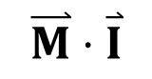
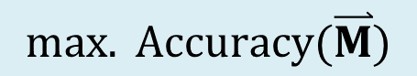
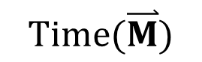
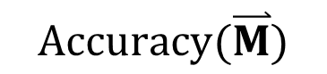
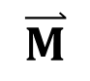
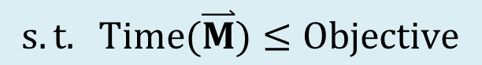
Problem Formulation of Elastic Tensor Selection
Maximize the model accuracy with the speedup objective in wall-clock time
$$max. Accuracy(\overset{⃑}{M})$$
$$s.t. Time(\overset{⃑}{M})≤Objective$$
binary selector
0
0
1
1
0
1
… …
$$\overset{⃑}{M}$$
[0 0 1 1 0 1 …]
$$Accuracy(\overset{⃑}{M})$$
$$\overset{⃑}{M}⋅\overset{⃑}{I}$$
Cumulative importance of selected tensors
$$Time(\overset{⃑}{M})$$
Time of training selected tensors
Challenge 1: How to adaptively evaluate tensor importance at runtime?
Challenge 2: How to construct time model of NN training?
Challenge 3: How to efficiently solve selection problem at runtime?
Notes:
More specifically, we would like to ensure training speedup on practical devices, and so in our approach we measure and optimize the training time in wall-clock time. To achieve the specified training objective, there are several technical challenges need to be solved.
[x] First, the practical model accuracy we can achieve rely on appropriate evaluation of the tensor importance, and in particular, we will need to use a tensor importance metric that satisfies additivity to calculate the cumulative importance of multiple selected tensors.
[x] Second, how do we appropriately estimate the time needed for neural network training, which may involve both forward and backward paths.
[x] Third, this problem of tensor selection is a typical constrained optimization problem which is NP-hard. How can we find a good approximate solution with the minimum computing cost at run-time?

Slide 10
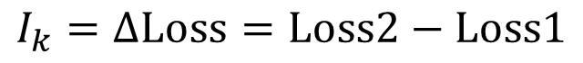
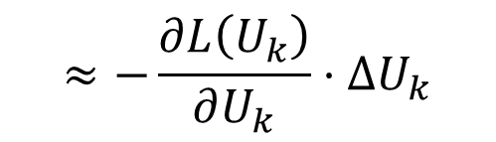
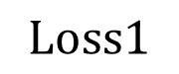
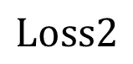
Solving Challenge 1: Evaluating Tensor Importance
Key Insight: tensor importance changes at runtime
Well-trained tensors are less prioritized for selection
Well-trained tensors on old data may need further training on new online data
Metric Definition: how much training loss will increase back, if undo its update
Tensor 1
Tensor 2
Tensor k
Tensor N
Original
Updated
$$Loss1$$
Undo update of tensor k
$$Loss2$$
$$≈−\frac{∂L\left(U_{k}\right)}{∂U_{k}}⋅ΔU_{k}$$
Periodically evaluate with randomly sampled training data
$$I_{k}=ΔLoss=Loss2−Loss1$$
Notes:
To solve the first challenge, the tensor importance metric should capture the run-time variation of tensor importance as training progresses. To achieve this, we define our tensor importance as its contribution to reducing the training loss, and in practical systems, we measure this contribution by measuring the change of training loss if we undo the tensor’s update in the current training epoch.
[x] In this way, with modern NN libraries such as TensorFlow and Pytorch, the importance of all the tensors can be computed in one shot with gradient-based approximation, and so the computing cost is minimized.
[x] At runtime, we periodically compute tensor importance with randomly sampled training data.

Slide 11

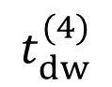
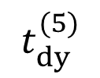
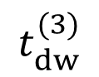
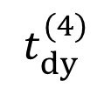
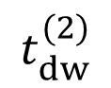
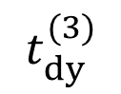
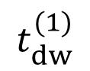
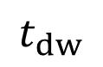
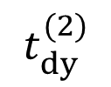
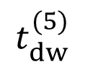
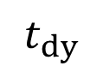
Solving Challenge 2: Construct Tensor-level Time Model
Generalization from the layer-level time model
$$t_{dw}^{(1)}$$
$$t_{dw}^{(2)}$$
$$t_{dw}^{(3)}$$
$$t_{dw}^{(4)}$$
$$t_{dw}^{(5)}$$
1
2
3
2
3
4
5
Input
Pred.
$$t_{dy}^{(2)}$$
$$t_{dy}^{(3)}$$
$$t_{dy}^{(4)}$$
$$t_{dy}^{(5)}$$
Label
Per-layer weights
$$t_{dy}$$
Time of propagating error gradient
Forward pass
$$t_{dw}$$
Time of computing weight update from error gradient
Backward pass
Can this model generalize to tensor-level selection?
Time to include when only training layer (3)
Notes:
To solve second challenge of measuring the tensors’ timing in training, we construct the tensor-level time model. our basic idea of constructing this model is to start from the commonly used layer-level time model and then make generalization. So let’s first look at the layer-level time model.
[x] For example, in this 5-layer NN, during training,
[x] the NN will first do a forward pass to get prediction results and compute the loss function with labels.
[x] Then in the backward pass, the error gradients will go through every layer for weight update. Overall, the computing time of the backward pass is the majority of training’s computing time, and it contains two parts: the time of error gradient propagation (t_dy) and the time of computing weight update from error gradient (t_dw).
[x] Suppose we only want to select layer 3 for training, the total backward time should be layer 3’s own time of computing weight update (tdw3), and the time of passing the error gradient all the way from the last layer to layer 3, including tdy4 and tdy5.
[x] Based on the layer-level time model, our question is: can the same rule apply to tensor level selection?

Slide 12
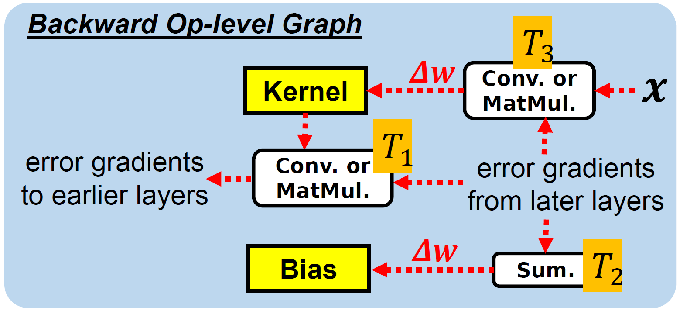
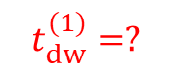

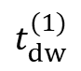
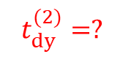
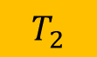
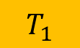
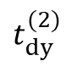
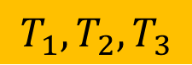
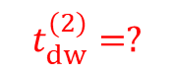
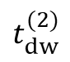
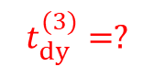
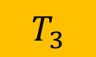
Solving Challenge 2: Construct Tensor-level Time Model
(2) Match with related operator timings
(1) Consider each tensor as a mini-layer.
$$t_{dw}^{(1)}$$
$$t_{dw}^{(2)}$$
Layer 1
Layer 2
Kernel
Bias
$$t_{dy}^{(2)}$$
Kernel
Bias
Unroll
Layer 1
Layer 2
Layer 3
Layer 4
Kernel
$$t_{dy}^{(2)}=?$$
Bias
$$t_{dy}^{(3)}=?$$
Kernel
Bias
$$0$$
$$T_{1}$$
$$t_{dw}^{(1)}=?$$
$$t_{dw}^{(2)}=?$$
$$T_{3}$$
$$T_{2}$$
$$T_{1},T_{2},T_{3}$$
Timing of Related Operators
Notes:
To make such generalization,
[x] we consider each tensor as a mini-layer, and unroll all the NN tensors into a layer-based representation.
[x] Then, to determine the tensor timings, we extract the timings of related operations in the backward computing graph, and match these operations to the corresponding tensors.
In our work, we apply such rationale to obtain the tensor timing model for different types of layers, such as convolutional, dense, batch normalization and non-trainable layers.

Slide 13




Solving Challenge 3: Tensor Selection with Dynamic Programming
Tensor Selection Problem is NP-hard !
Start from solving easier sub-problems:
Objective $≤t$
P[k = 1, t = 1]
P[k = 1, t = 2]
P[k = 2, t = 1]
Backward Depth $≤k$
P[k = N, t = Objective]
Find recurrence relations between sub-problems:
e.g.,
If $k^{th}$ tensor is not selected, then P[k, t] will fall back to P[k-1,t].
Notes:
With the knowledge of tensor importance and timings, we use dynamic programming to find a good approximate to the solution in pseudo polynomial time.
[x] The basic idea is to start from solving easier sub-problems by reducing the backward depth and objective of backward pass. We can obtain the solution to the original problem by recursively solving all the subproblems.
[x] The recurrence relations of subproblems can be found by discussing the cases of whether the new tensor in the current subproblem is selected or not.
For example, if the new tensor is not selected, then the current subproblem can be fall back to the previous subproblem and share the same solution. Please refer to our paper for more case discussion and detailed algorithms.

Slide 14


Putting them together
Tensor Timing Profiler
Tensor Importance Evaluator
Training data
Layer 1
Layer 2
Layer 3
Pred.
Label
NN
Tensors
Tensor-level Graph
Tensor Importances
Loss
Layer 1
Layer 2
Layer 3
Tensor Timings
Tensor Selector
$$\max{ \vec{M}⋅\vec{I}}$$
Sub-problem Space
$$s.t. T_{sel}(\vec{M})≤ρT_{full}$$
P1
P5
P10
Standard Profiler
Optimal Selection Strategy (M)
Operator timings
Sub-problem definition
DP
P20
Notes:
After addressing these challenges, we put all the modules together and have our full design of ElasticTrainer.
[x] At offline stage, the tensor timing profiler estimate tensor timings by aggregating timings of relevant NN operators in each tensor [x].
[x] At online stage, the tensor importance evaluator keeps monitoring tensor importance.
[x] The tensor timings and importance scores are sent to the tensor selector to produce the optimal selection strategy using dynamic programming at runtime

Slide 15


Implementation & Evaluation Setup
Devices for NN training
GPU Platform: Nvidia Jetson TX2 + SATA SSD
CPU Platform: Raspberry Pi 4B
Training code is implemented using TensorFlow
Baselines
Full training: train all NN weights
Traditional TL [1, 2]: train only last a few prediction layers
BN + Bias [3, 4]: train bias weights & batch normalization layers
PruneTrain [5]: online pruning
Large variance in the same category, small variance in different categories
Models & Datasets
ResNet50, VGG16, MobileNetV2, Vision Transformer
CUB-200, Stanford Dogs, Oxford Pets for fine-grained image classification
[1] J. Donahue et al. Decaf:A deep convolutional activation feature for generic visual recognition. ICML 2014
[2] K. Simonyan et al. Very deep convolutional networks for large-scale image recognition. ICLR 2015
Difficult fine-grained image classification datasets
[3] H. Cai et al. Tinytl: Reduce activations, not trainable parameters for efficient on-device learning. NIPS 2020
[4] P. K. Mudrakarta et al. K for the Price of 1: Parameter-efficient Multi-task and Transfer Learning. ICLR 2019
[5] S. Lym et al. Prunetrain: fast neural network training by dynamic sparse model reconfiguration. SC’19
Notes:
We implement ElasticTrainer using tensorflow on two types of commonly used embedded devices, Nvidia Jetson and Raspberry Pi.
In our evaluation, we compare ElasticTrainer with multiple baselines that cover full training, offline and online selection schemes.
We choose widely used convolutional models such as ResNet50 and MobileNetV2, and Transformer models for evaluation.
The training is conducted on multiple fine-grained image classification datasets. These datasets are generally challenging because there are large variance in the same category, but small variance in different categories.

Slide 16




Training Speedup & Accuracy on Nvidia Jetson TX2
Speedup objective is set as 2x
Notes:
First, we show the training speedup and accuracy that we achieved on the Nvidia Jetson. The speedup objective was set to be 2 times. We can see that our approach improves the model accuracy faster compared to other schemes, and take 50% of time compared to full training to achieve the same accuracy. On some datasets, ElasticTrainer even achieves higher final accuracy than full training.
Overall, ElasticTrainer can achieve up to 3 times of wall-clock time speedup compared to full training without noticeable accuracy loss, and also significant speedup compared to other existing schemes.

Slide 17

Training Speedup & Accuracy on Raspberry Pi
Notes:
On raspberry Pi, ElasticTrainer achieves the similar performance, with faster training and better convergence.

Slide 18


With Different Speedup Objectives
On Nvidia Jetson TX2
Up to 3.7x wall-time speedup without noticeable accuracy drop
Up to 65% of FLOPs saving
Up to 20% higher accuracy than baselines
On Raspberry Pi 4B
Up to 3.2x wall-time speedup without noticeable accuracy drop
Up to 65% of FLOPs saving
Up to 20% higher accuracy than baselines
Notes:
To investigate the performance limit of ElasticTrainer, we try different speedup objectives on both Jetson and Raspberry Pi. Such objective is specified with the parameter rho, such that the training time with our approach is expected to be rho percent of the full training.
The results demonstrate that our dynamic programming algorithm can produce good selection strategies that satisfy different speedup objectives. Overall, ElasticTrainer can achieve up to 3.7x wall-time speedup and save up to 65% training FLOPs without noticeable accuracy loss.

Slide 19

Performance on Different NN Models
ResNet50
2.5x-3x speedup to full training
With little accuracy loss
VGG16
2x-3x speedup to full training
Up to 10% higher accuracy
MobileNetV2
4x speedup to full training
Up to 20% higher accuracy
Vision Transformer (ViT)
3x speedup to full training
Up to 10% higher accuracy
Notes:
Over different NN models, ElasticTrainer can constantly achieve 2x-4x training speedup without noticeable accuracy loss. For big models such as VGG16 and transformer, ElasticTrainer can achieve higher speedup due to higher redundancy of model weights. For the lightweight model MobileNetV2, ElasticTrainer can greatly improve model convergence by focusing on training top important tensors and reducing overall noise in the training feedback.

Slide 20

Behavior of Elastic Tensor Selection
Gradually select more tensors in shallow layers
Skip tensors in deeper layers to maintain speedup
Low activity when requiring high speedup
Notes:
The good performance of ElasticTrainer stems from its elastic selection behavior. We use heatmaps to mark the selected tensors for each training epoch.
[x] We can observe that more and more tensor in shallow layers will be selected as training progresses. This tells that the important tensors are moving from deep layers to shallow layers during training, and ElasticTrainer can effectively capture such shift.
[x] In the meantime, ElasticTrainer tries to skip less important tensors in deeper layers to maintain overall speedup.
[x] Using a higher speedup objective will result in less changes of the selected tensors over different epochs.

Slide 21


Local Resource Usage
Memory usage
No significant increase compared to full trainng
Energy consumption
Saves >60% energy to full training
10%-20% higher than other selection schemes
Notes:
We also evaluate the memory usage and energy consumption. The results show that ElasticTrainer has no significant memory increase compared to full training. It can save over 60% of energy while achieving 10%-20% higher accuracy.

Slide 22
Summary
ElasticTrainer: adaptively select trainable tensors for desired speedup
Achieve up to 3.7x speedup in wall-clock time and 2x-3x energy saving , without noticeable accuracy loss
Generally applicable to different types of NN models and datasets
Notes:
To wrap things up, in this paper, we propose ElasticTrainer, a new on-device training technique that can adaptively select trainable tensors for desired speedup. It can achieve 3.5x speedup and 2x-3x energy saving without noticeable accuracy loss. Our scheme can generally apply to any NN models.

Slide 23
Thank you!
Source codes:
https://github.com/HelloKevin07/ElasticTrainer
Notes:
Our project is open-sourced and please refer to our paper for more details. Thank you!

Slide 24








Solving Challenge 3: Tensor Selection with Dynamic Programming
Problem Formulation
NP-hard!
Define subproblems
$$\max_{M}{ M}⋅I$$
$s.t. T\left(M\right)≤{ρT}_{full}$
$M$ – binary selector
$I$ – importance scores
$ρ$ – speedup ratio
$T(⋅)$ – time model
Find recurrence relations
Notes:
With the time model and evaluated importance scores, we formulate the tensor selection problem as a constrained optimization problem.
[x] Due to its NP-hardness, we want to use dynamic programming to solve it in pseudo polynomial time.
[x] The basic idea is to incrementally downscale the problem complexity by reducing the depth and total time of backward pass. We can have a subproblem table by enumerating all the possible subproblems.
[x] By finding the recurrence relation between these subproblems, we can start from the easiest subproblem, and solve all subproblem sequentially and eventually get the solution to the original problem.

